Slide 1
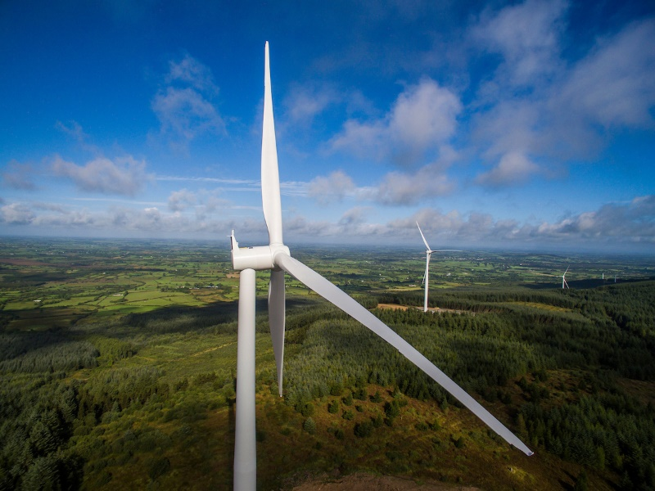
An Bord Pleanála
Ballyfasy Wind Farm,
Co. Kilkenny
Pre-Planning Application Update & Design Flexibility Meeting
26. 05. 25

Slide 2

Overview
Introduction to the Project Team
Project Recap
Project Description updates since pre-application meeting on 20th of November 2024
Design Flexibility

Slide 3
Project Team
Developer
Manogate Ltd - a joint venture company established for this project by Art Generation and FuturEnergy Ireland (FEI).
ART Generation Ltd:
Established wind developer in Ireland involved in project development, construction & operation. Recent developments in Tullaroan, Ballybeagh and Ballysloe in Kilkenny.
FEI:
In November 2021, Coillte and ESB joined forces to launch their joint venture company FuturEnergy Ireland. FuturEnergy Ireland’s mission is to maximise the potential of our unique wind and land resources and accelerate Ireland’s transformation to a low carbon energy economy.
*Art Generation Ltd. and FuturEnergy Ireland were involved in the nearby Castlebanny Wind Farm, Co. Kilkenny (ABP Case No. 309306).
Lead Consultants
TOBIN - lead environmental and planning consultants on behalf of Manogate Ltd.
Key EIAR Subs- Macroworks, AWN, Irish Archaeological Consultancy Ltd, Western Forestry Co-Op, Causeway Geotech Ltd.

Slide 4
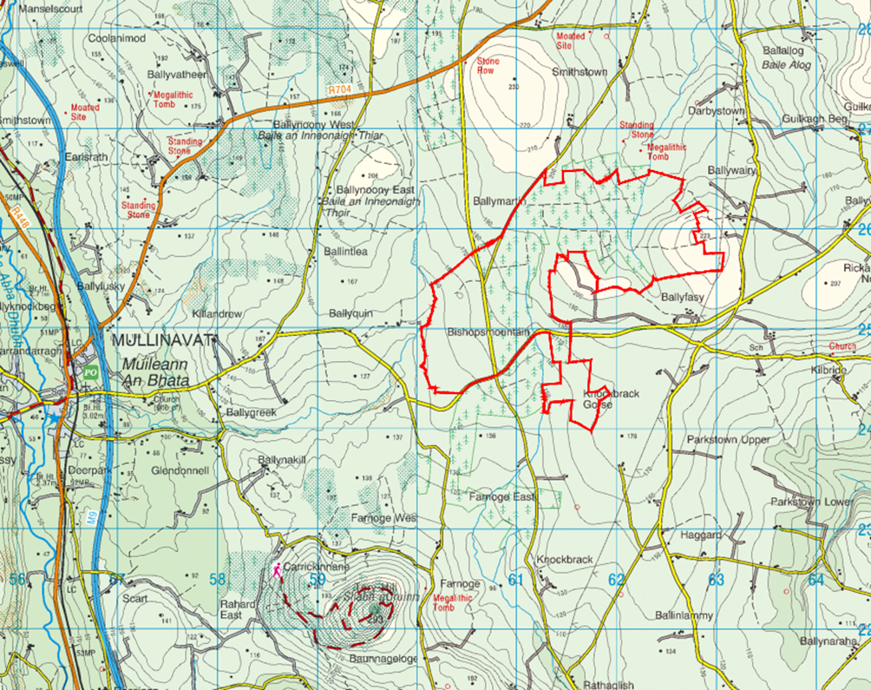

Site Location and Description
The proposed Ballyfasy wind farm is located between the villages of Listerlin to the northeast, Mullinavat to the west, Glenmore to the southeast, and Slieverue to the south.
The wind farm planning application area is approximately 343 hectares and is outlined in red.
The area can be described as rural with dispersed settlement type.
Significant areas of the study area are privately owned grassland and Coillte forestry.

Slide 5
Project Description Updates
Project Description
Wind Farm with 10 turbines proposed ~ 72 MW capacity.
Turbine blade tip height in the range of (and including) 169 metres (m) minimum to 180 m maximum, a rotor diameter of between 130 m-163 m and a hub height of 95 m-112 m.
The wind farm development will also include:
Associated hard standings at each turbine location;
New access roads and upgrading of existing access roads;
New site entrances and modifications to existing entrances;
Provision of site drainage;
3 no. onsite clear-span bridges;
100 m meteorological mast;
2 Temporary construction compounds;
2 Borrow pits;
An onsite 110 kV electricity substation;
Electrical and communication cables; and
Related site works and ancillary works.
Works on private lands along turbine delivery route (TDR).

Slide 6
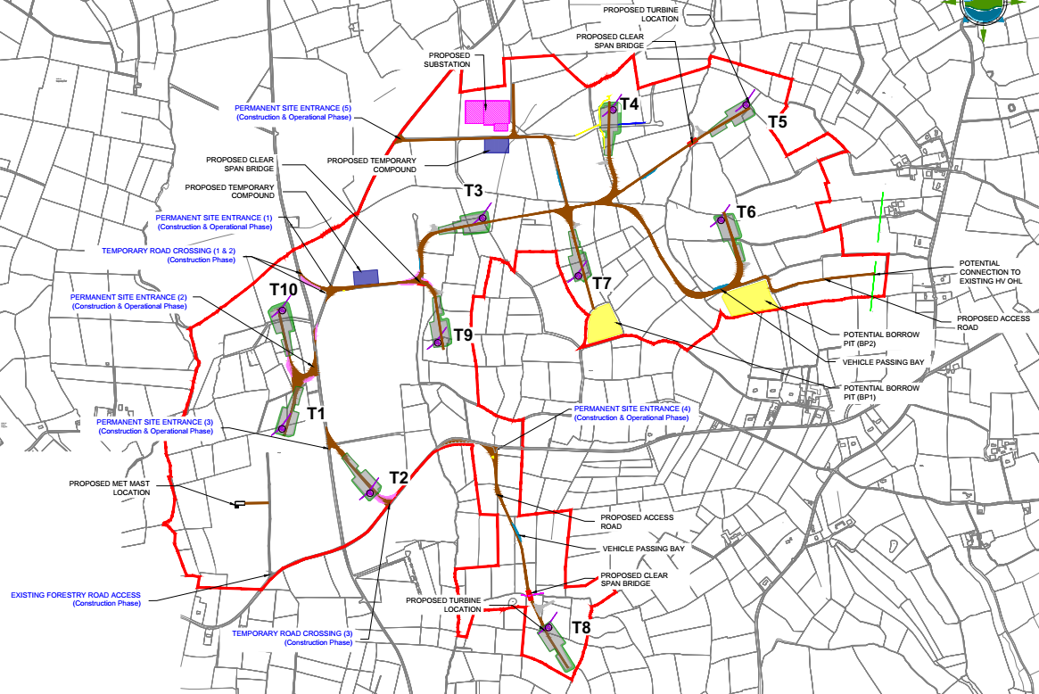
Site Layout

Slide 7
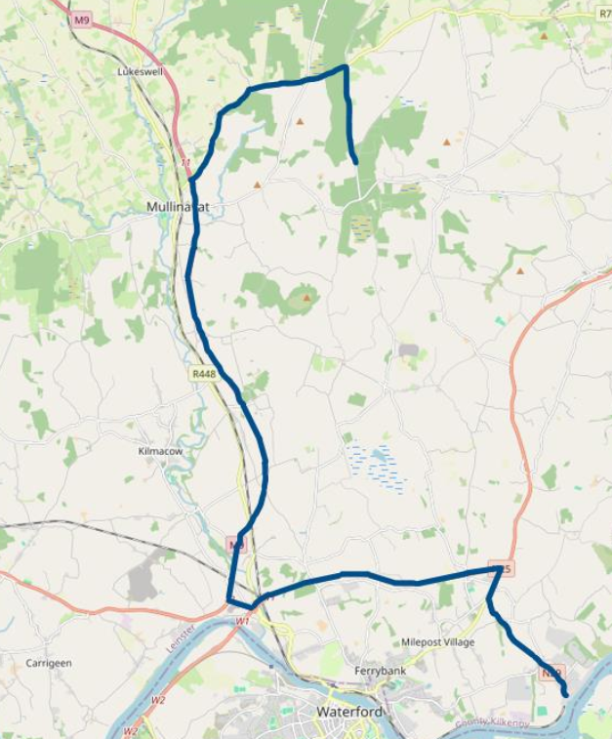
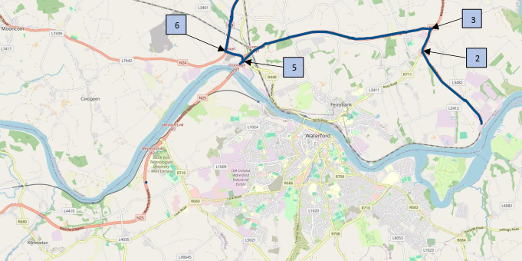
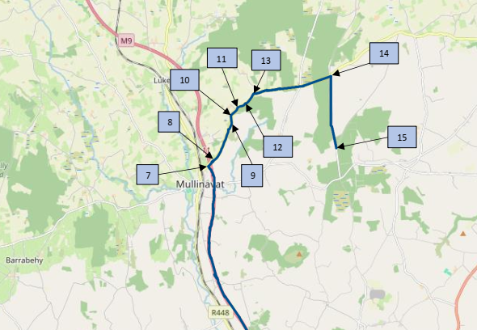
Turbine Delivery Route

Slide 8
Design Flexibility
Details Unlikely to be Confirmed at Application Lodgement
The details of the proposed development unlikely to be confirmed at the time of the proposed application are as follows:
Turbine Total Tip Height
Turbine Rotor Diameter
Turbined Hub Height
Substation Layout
The parameters within which the turbine specifications will fall are as follows:
Total tip height range of 169m – 180m
Rotor diameter range of 130m – 163m
Hub height range of 95m - 112m
Each turbine will be capable of generating from 4.2MW to 7.2MW, with an overall installed capacity of between 42MW to 72MW inclusive.

Slide 9
Design Flexibility
Details Unlikely to be Confirmed at Application Lodgement
The substation layout.
Two grid connection options are being considered for this project. These will be applied for under a separate planning application. Only one grid connection option will be constructed. The grid connection option constructed will determine the substation layout required by the project. Both substation layout options are at the same location on the proposed wind farm site.
The proposed application will contain the necessary information and details of the parameters set out above on which the application can be made and decided.

Slide 10



Thank You
Galway
Dublin
Castlebar
Limerick
Sligo
Fairgreen House
Fairgreen Rd
Galway,
H91 AXK8
T: (091) 565 211
Block 10-4
Blanchardstown Corporate Park Dublin 15,
D15 X98N
T: (01) 803 0406
Market St
Castlebar
Co. Mayo,
F23 Y427
T: (094) 902 1401
Unit 4, Crescent Court,
St. Nessan’s Road, Dooradoyle, Limerick
V94 V298
T: (061) 574 413
First Floor, Carroll House, 15/16 Stephen Street Co Sligo
F91 ADK4
T: (071) 9318 844
www.tobin.ie \

